Slide 1


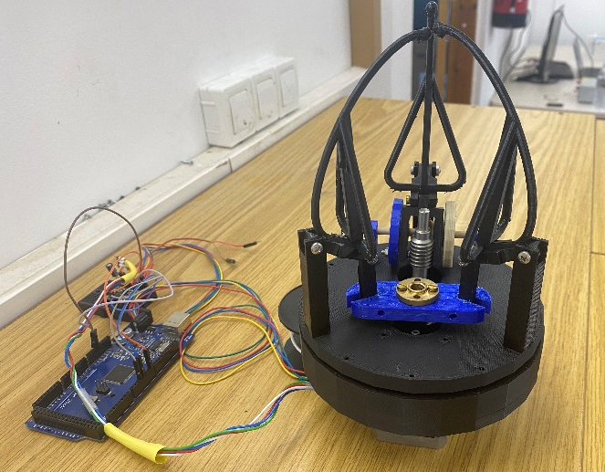
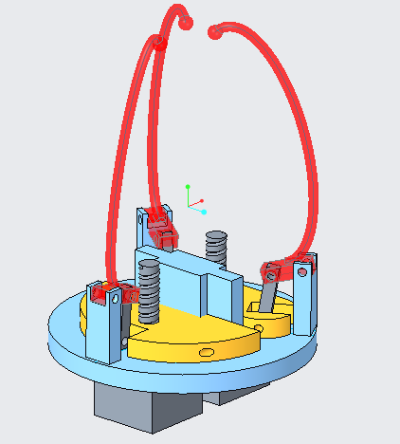
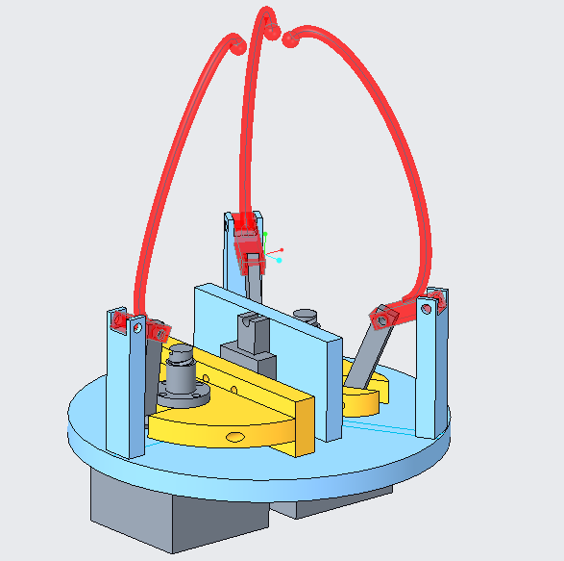
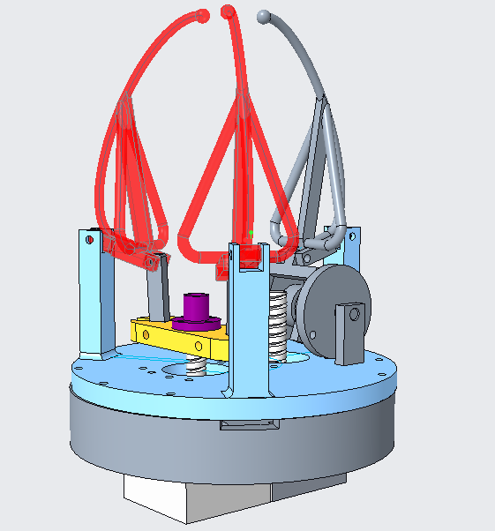
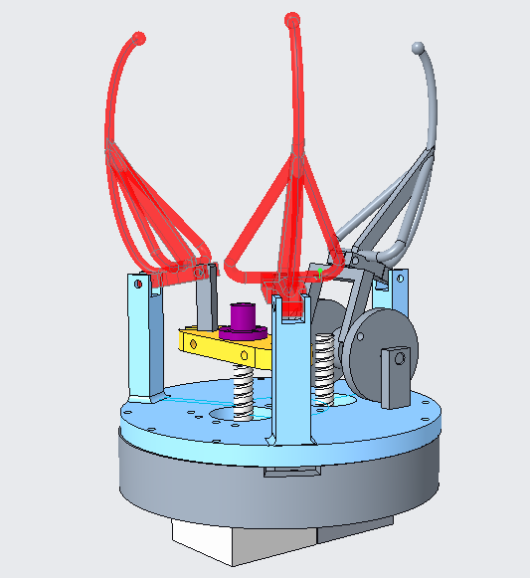
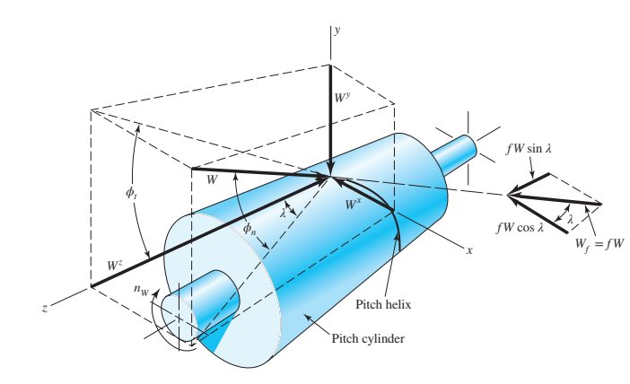
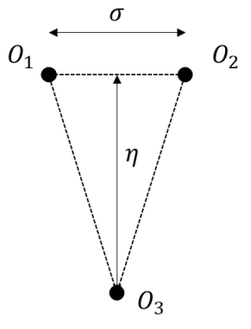
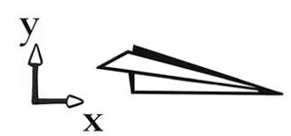
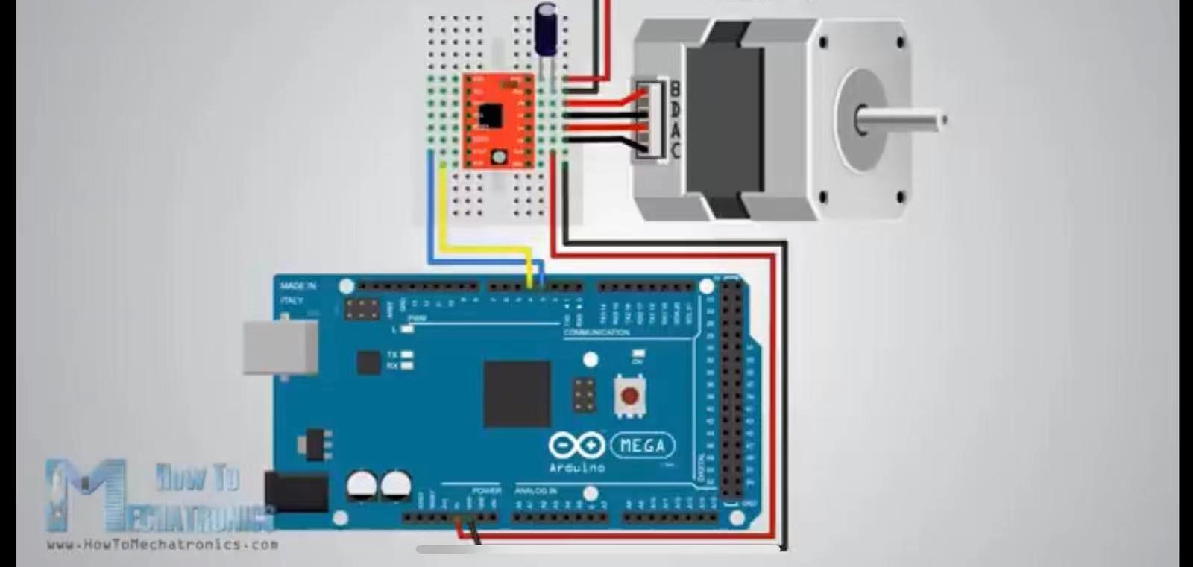

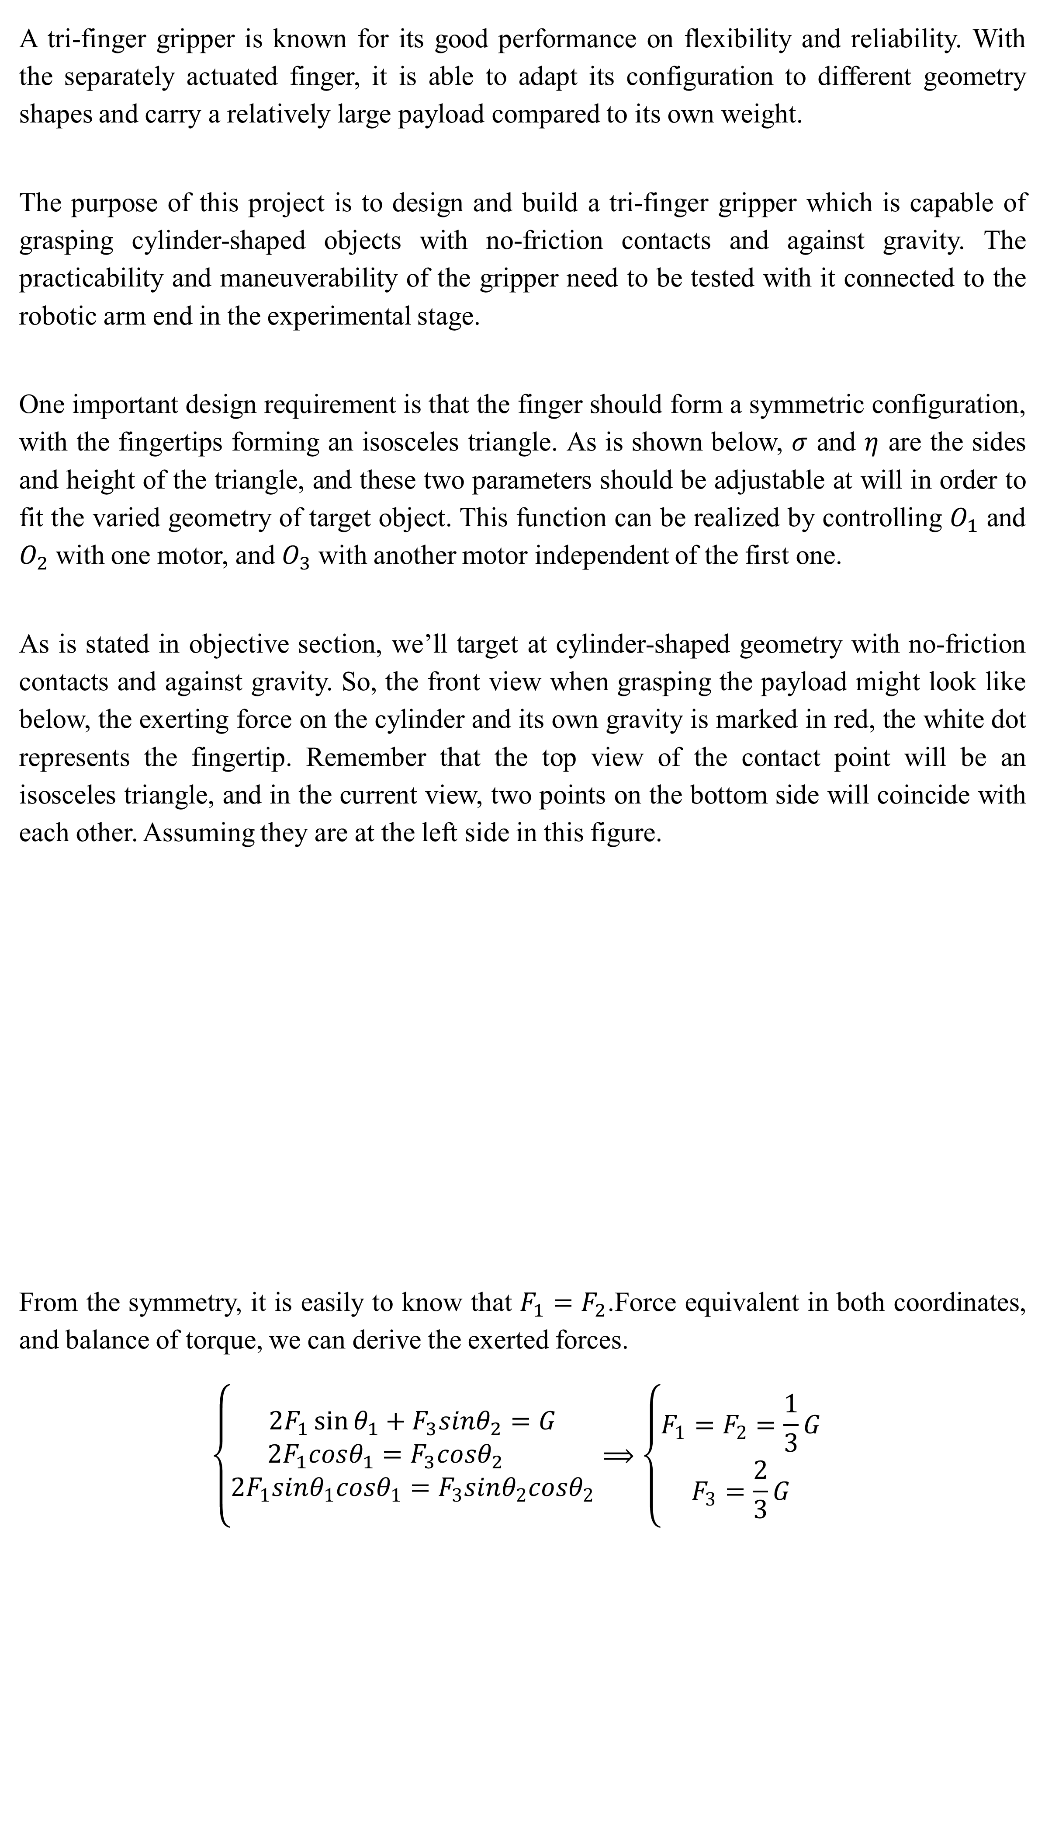
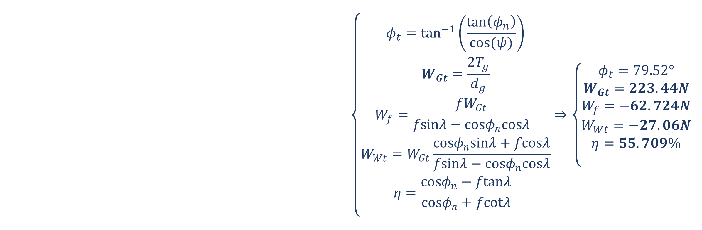




Design and Production of a Tri-Finger Gripper for Cylinder-Shaped Objects
Yousef Darwish, Zhiyuan Li
Supervisors: Prof. Elon Rimon, Alon Shirizly
Technion Autonomous Robotics Laboratory
Abstract
Design Iteration
The purpose of this project is to design and build a tri-finger gripper which is capable of grasping cylinder-shaped objects with no-friction contacts and against gravity in the experiment. As part of the project, multiple designs were proposed and kept being selected and modified until an appropriate prototype was determined. Then, the gripper was manufactured and assembled, and its feasibility was proven by the on-hand preliminary testing. In the next stage, our group integrated the Arduino-powered gripper with ROS and created an interface between the gripper and the robotic arm. Last, the grasping test was performed by controlling both the arm and gripper through ROS.
The gripper design experience three iterations:
In the 1st iteration, The finger is designed so that it only performs circular motion within a certain angle range. The motion is realized by adding two holes at the end of the finger, one of it is fixed to the extrusion of the gripper palm, and only allows rotation motion, and the other one is driven by the yellow platform through a connective rod. As the platform rises or falls due to the power screw, the motion of grasping and releasing object is completed. In the 2nd version, we replace it with a linear rail which enables smooth movement, avoiding the friction and torque due to the protrusion part.
This is the third proposed design, and our group also decided to continue with this one. Compared to the previous designs, the motion transition between the power screw and the finger is substituted by a worm drive. Such designs ensures a more precise control of the third finger, and a high transmission ratio in a space-saving manner. The finger is also modified for better stability. As is shown below, more supports are added on the body of finger in order to avoid bending in vertical and horizontal direction.
Objective and Design Requirement
A tri-finger gripper is known for its good performance on flexibility and reliability. With the separately actuated finger, it is able to adapt its configuration to different geometry shapes and carry a relatively large payload compared to its own weight.
The purpose of this project is to design and build a tri-finger gripper which is capable of grasping cylinder-shaped objects with no-friction contacts and against gravity. The practicability and maneuverability of the gripper need to be tested with it connected to the robotic arm end in the experimental stage.
One important design requirement is that the finger should form a symmetric configuration, with the fingertips forming an isosceles triangle. As is shown below, $σ$ and $η$ are the sides and height of the triangle, and these two parameters should be adjustable at will in order to fit the varied geometry of target object. This function can be realized by controlling $O_{1}$ and $O_{2}$ with one motor, and $O_{3}$ with another motor independent of the first one.
As is stated in objective section, we’ll target at cylinder-shaped geometry with no-friction contacts and against gravity. So, the front view when grasping the payload might look like below, the exerting force on the cylinder and its own gravity is marked in red, the white dot represents the fingertip. Remember that the top view of the contact point will be an isosceles triangle, and in the current view, two points on the bottom side will coincide with each other. Assuming they are at the left side in this figure.
From the symmetry, it is easily to know that $F_{1}=F_{2}$.Force equivalent in both coordinates, and balance of torque, we can derive the exerted forces.
$$\left\{\begin{aligned}2F_{1}\sin{θ_{1}}+F_{3}sinθ_{2}=G \\ 2F_{1}cosθ_{1}=F_{3}cosθ_{2} \\ 2F_{1}sinθ_{1}cosθ_{1}=F_{3}sinθ_{2}cosθ_{2}\end{aligned}⟹\left\{\begin{aligned}F_{1}=F_{2}=\frac{1}{3}G \\ F_{3}=\frac{2}{3}G\end{aligned}\right. \right.$$
Force Analysis on The Worm Gear
Illustrated below is the drawing of the pitch cylinder of a worm as well as the forces exerted upon it by the worm gear, and related formula we used to calculate forces, torque, and efficiency of the gear we used.
$$\left\{\begin{aligned}φ_{t}=\tan^{−1}\left(\frac{\tan\left(φ_{n}\right)}{cos⁡(ψ)}\right) \\ W_{Gt}=\frac{2T_{g}}{d_{g}} \\ W_{f}=\frac{fW_{Gt}}{fsinλ−cosφ_{n}cosλ} \\ W_{Wt}=W_{Gt}\frac{cosφ_{n}sinλ+fcosλ}{fsinλ−cosφ_{n}cosλ} \\ η=\frac{cosφ_{n}−ftanλ}{cosφ_{n}+fcotλ} \\ \end{aligned}⇒\left\{\begin{aligned}φ_{t}=79.52° \\ W_{Gt}=223.44N \\ W_{f}=−62.724N \\ W_{Wt}=−27.06N \\ η=55.709\% \\ \end{aligned}\right.\right.$$
Integration between Arduino-powered gripper and Robot Operating System (ROS)
$$F_{1(2)}$$
$$θ_{1}$$
$$θ_{2}$$
$$F_{3}$$
We use Arduino as the direct controller of the motors attached to the end of the gripper, and an interface between the gripper and the robotic arm is realized by ROS. A URDF model of the gripper is also built so that a simulation of the grasping process could be launched in the environment of ROS.
$$G$$

